Slide 1
Power of Serverless Computing
BSC IT Cloud Engineering Team

Slide 2
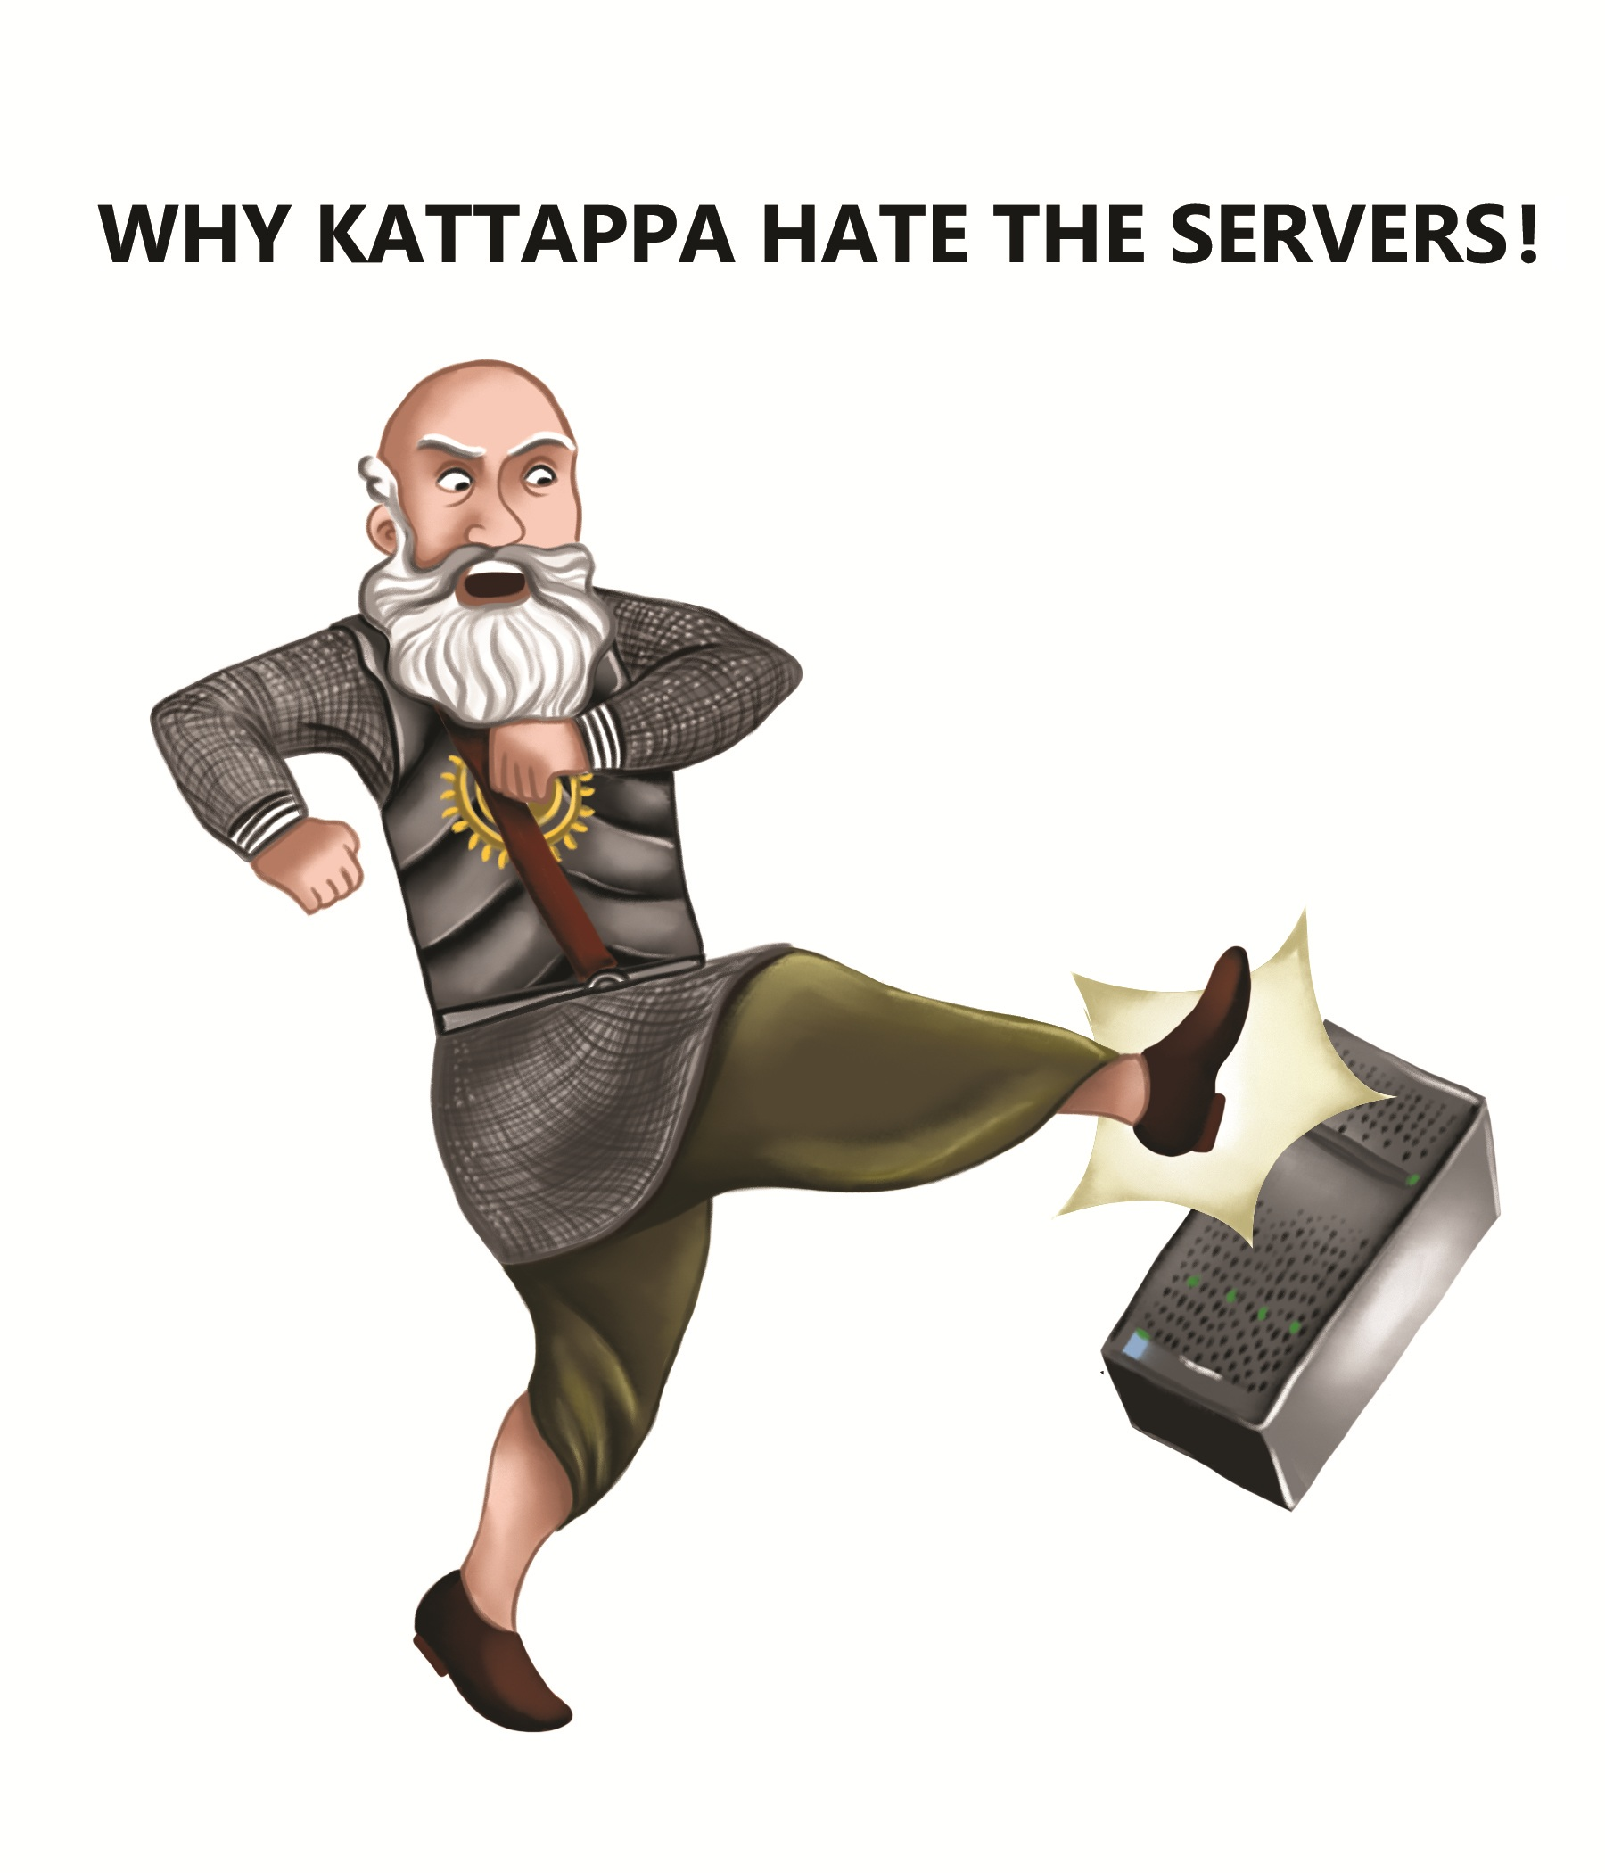
Serverless Computing – NoOps but InVisibleOps

Slide 3
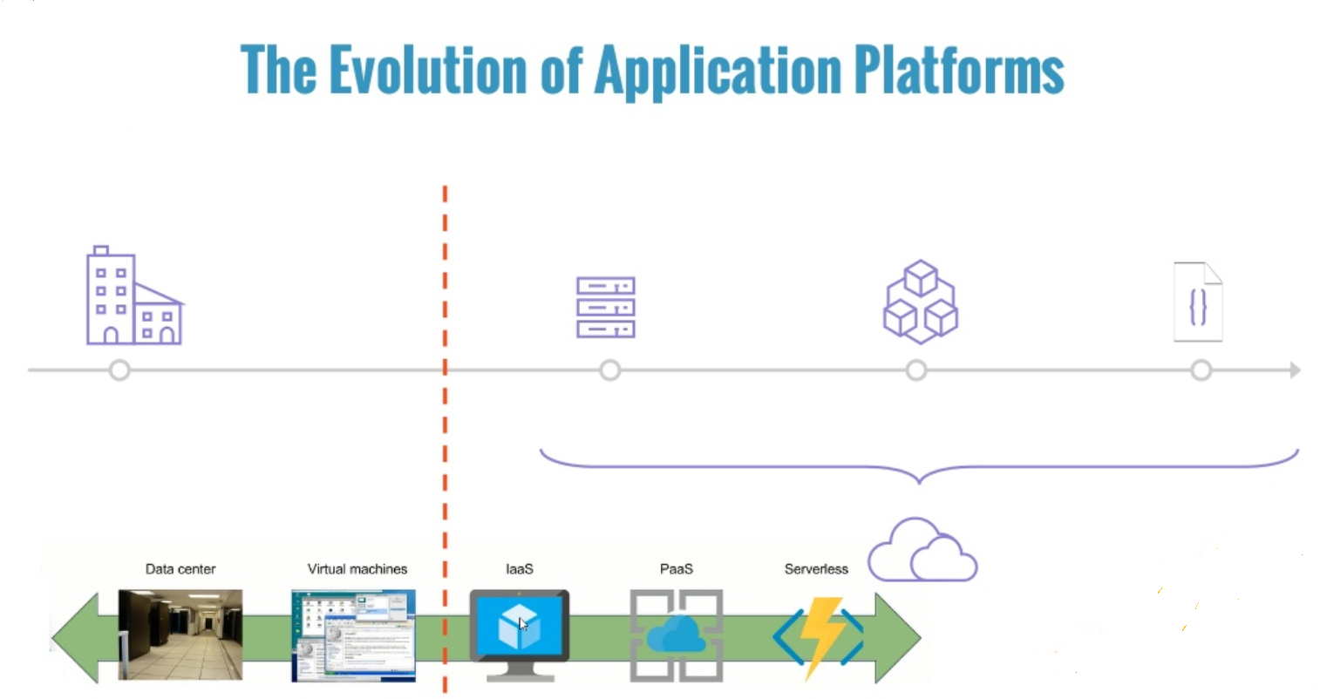
Serverless Evolution

Slide 4
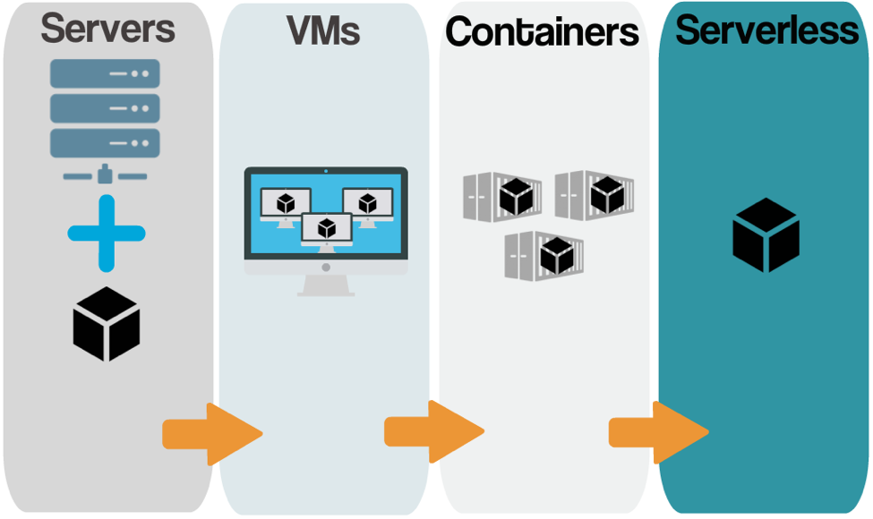
What is Serverless ..

Slide 5
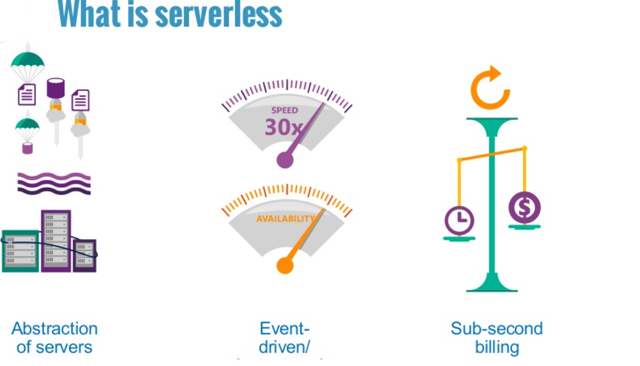

Slide 6
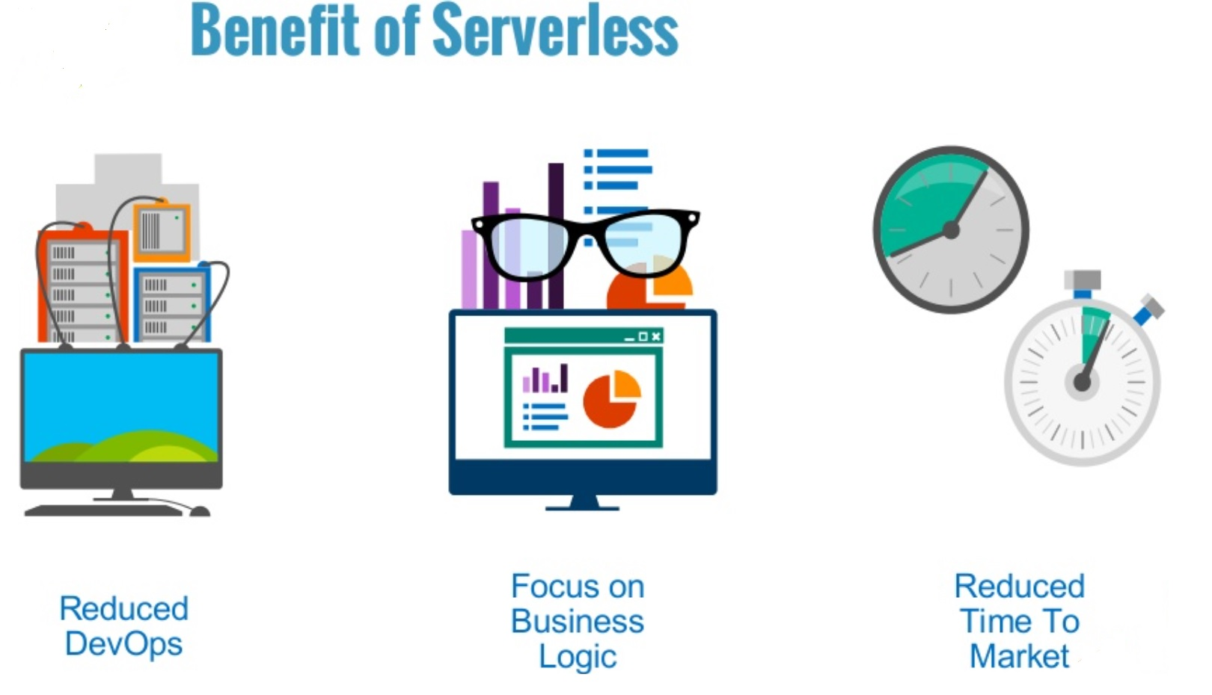
Benefits of Serverless

Slide 7
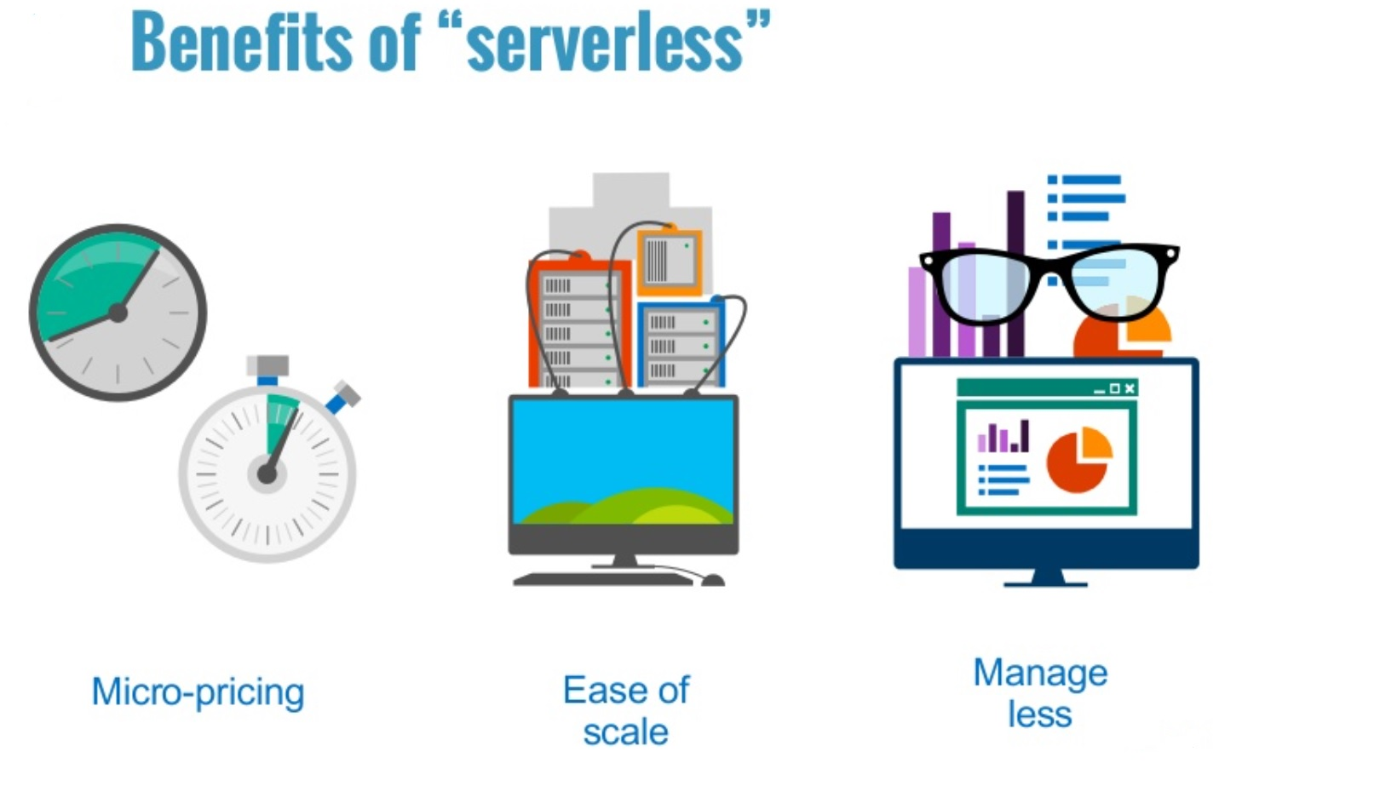
Benefits of Serverless

Slide 8
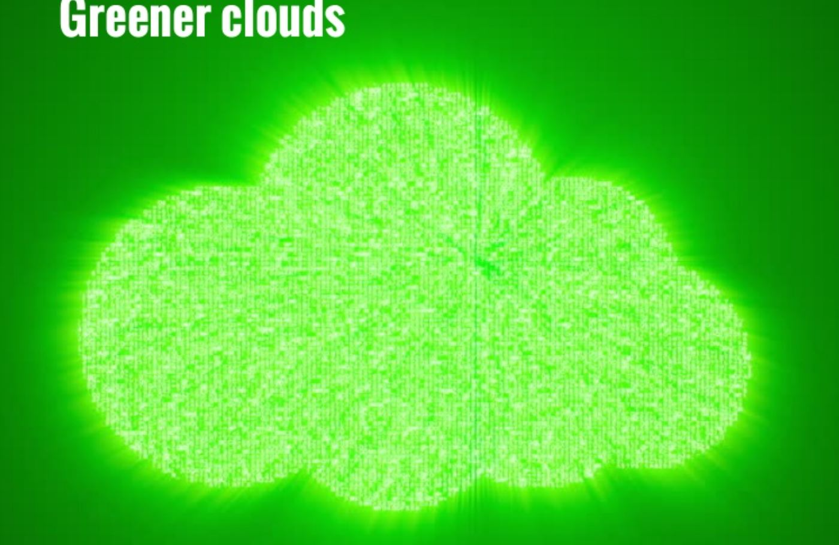
Green Computing

Slide 9
Didn’t get it , please explain better !!
“Function-as-a-Service” (FaaS) Model.
“Pure” execution Platform
No Infrastructure provisioning , No Configuration Management and No patch cycles.
True “On Demand”
Rapidly Scalable
DevOps to InVisible-Ops ( Do not consider it NoOps)

Slide 10
Serverless Model Watch Points
Statelessness
Limited execution duration
Limited Native Runtime Support
Artefact Size
Rapidly Scalable
Cold Start time
Concurrent execution limit
Multitenancy
Compliance

Slide 11
Lambda Use Cases
Web Services with API Gateway
Batch data processing
AWS Environment Automation
Analytics
Log ingest and Analysis
Artefact Build and test
Event Driven processing
AWS Step functions

Slide 12
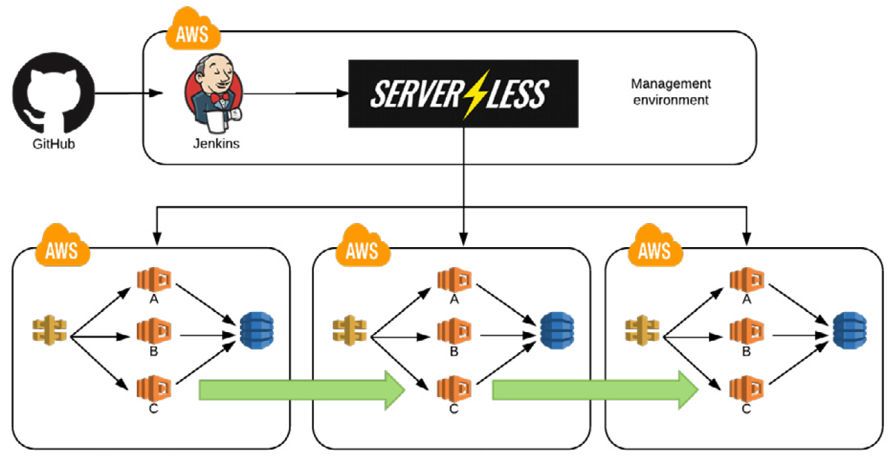
CI/CD Pipeline using Lambda
dev.app.domain.com
test.app.domain.com
prod.app.domain.com

Slide 13
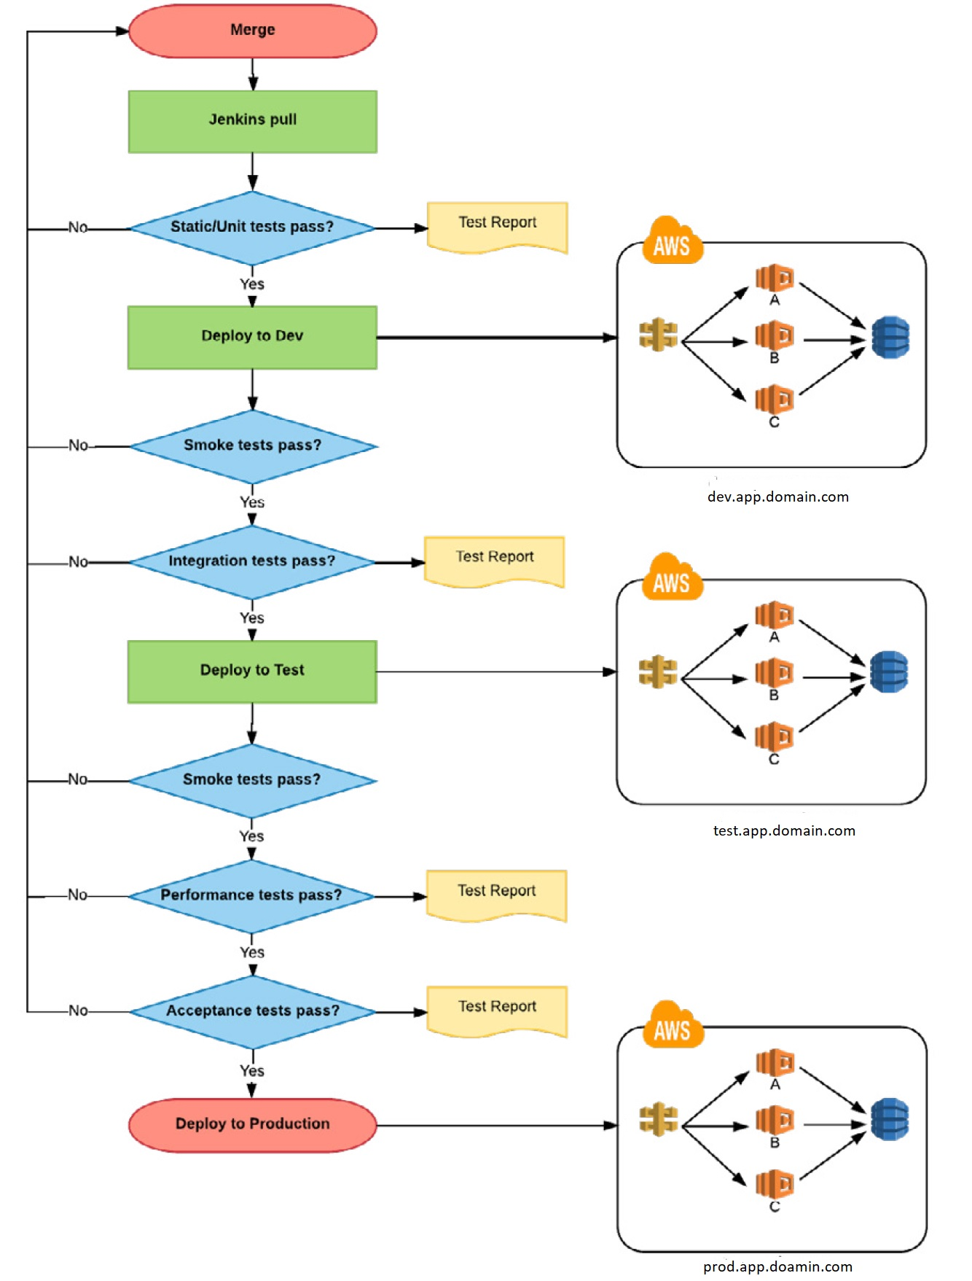
CI/CD Pipeline using Lambda
https://s3.amazonaws.com/serverless-ppt/jen.jpg

Slide 14
Monitoring Serverless Applications
G.A.P Monitoring Systems ::
G- Grafana
A – Alert manager
P - Prometheus

Slide 15
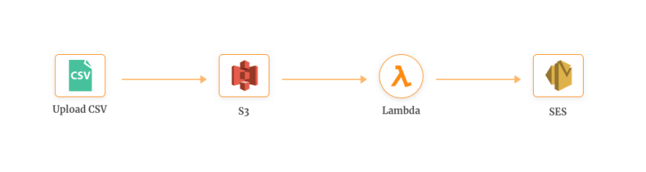
Demo Time !!
DEMO 1 :: Serverless Mass Email Solution

Slide 16
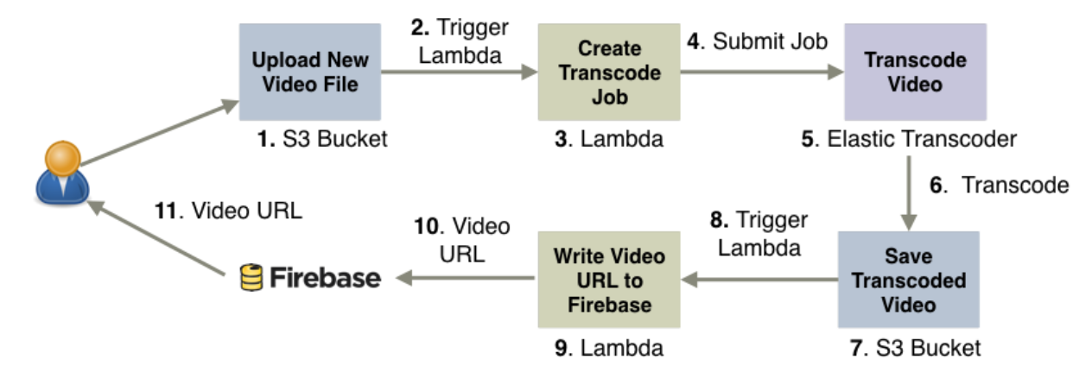
Demo Time !!
DEMO 2 :: Serverless Video On Demand

Slide 17
Demo Time !!
DEMO 3 :: Infrastructure Automation On Cloud using Terraform – Jenkins
Objective of Automation ::
creating VPC
creating Internet Gateway
Create Autoscaling Group
Create load balaner to point to webserver
Open TCP port 80 to allow incoming traffic from the world
create 3 IAM users and should only allow to restart web servers.
Tools ::
Version Control : github
CI tool : Jenkins
Automation tool : terraform
Hosting : AWS
Process : Developer commit the code
Jenkins polls the github
Infrastructure gets deployed on AWS with no manual intervention.

Slide 18
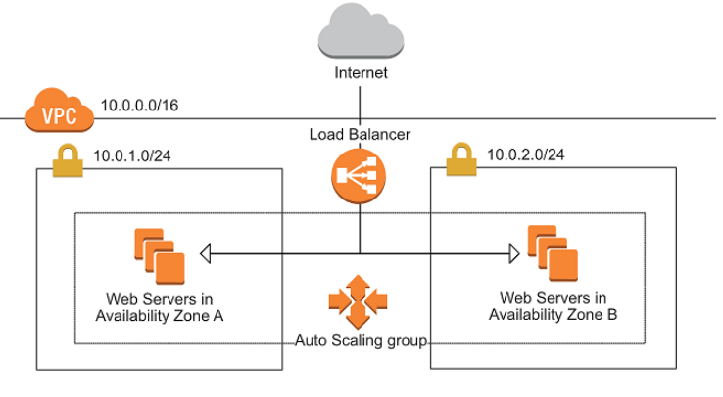
Demo Time !!
DEMO 3 :: Infrastructure Automation On Cloud using Terraform – Jenkins

